Slide 1
Answering from Documents
How does ChatGPT answer questions using uploaded documents?
How can an AI system give answers only from company knowledge files?
How does retrieval improve accuracy compared to plain LLM answers?

Slide 2
RAG
RAG (Retrieval-Augmented Generation)
Converse with our own documents / data
LLMs are limited – they don’t know what they don’t know
RAG solves the problem of hullicination

Slide 3
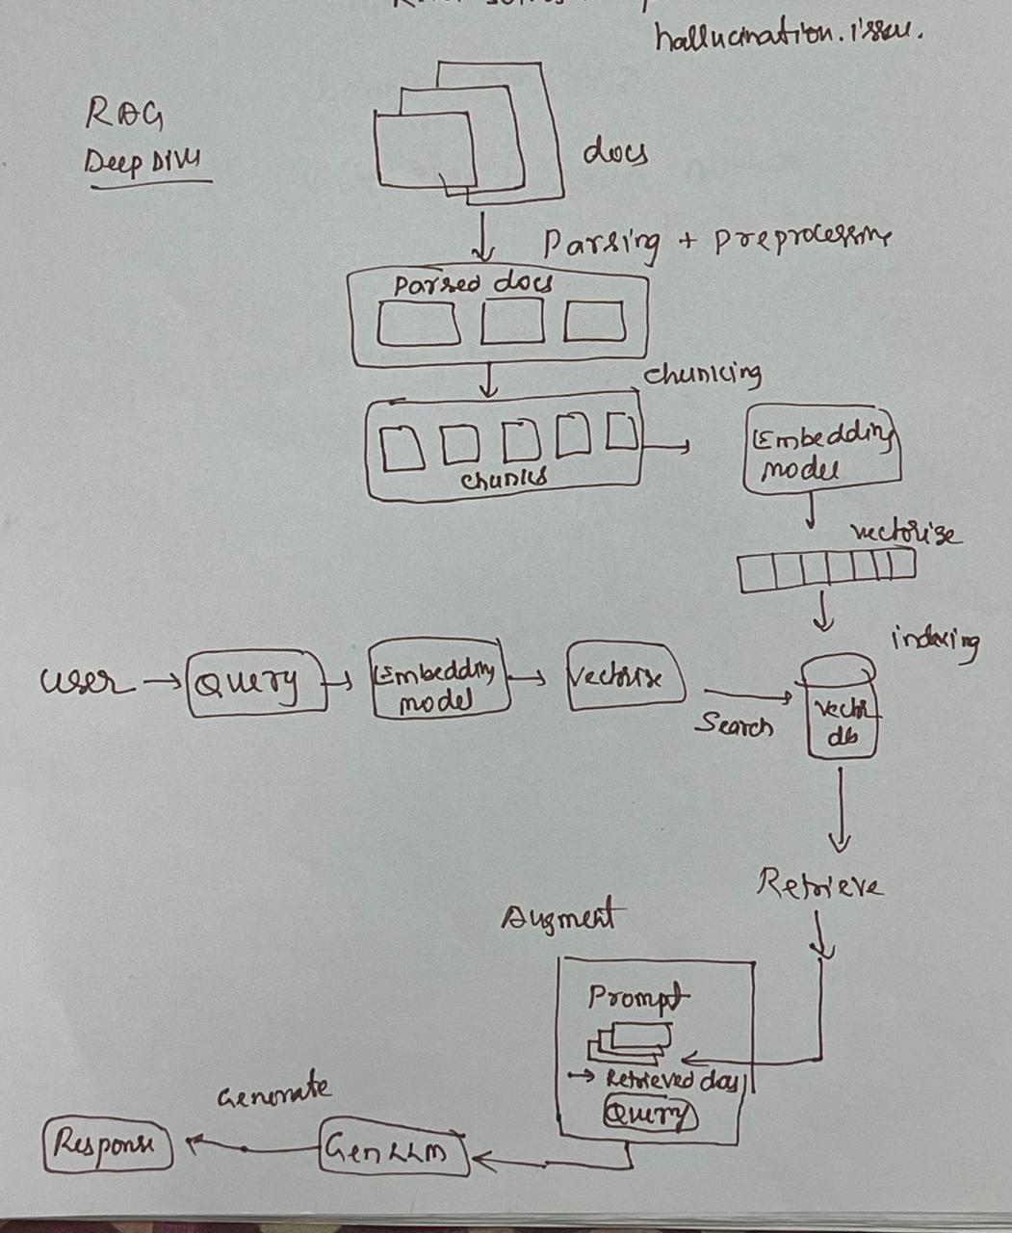

Slide 4
Why Use RAG?
Keeps LLM responses grounded in facts
Reduces hallucinations
You can keep your data private
You can answer questions on any document or domain

